Slide 1
Data Management Services
Narges zarrAbi
Data Management Course - Vrije Universiteit Amsterdam
14th November 2018

Slide 2
Course Outline
Data Management Services at SURFsara (45 min)
Data Archive Infrastructure and Access (50 min)
Access Archive via GUI (Demo)
Access Archive via command line (hands-on)
Break (15 min)
Data Management with iRODS (30 min)
iRODS icommands (hands-on) (40 min)
iRODS GUI Demo (30 min)
Notes:
We will show you some tools that can help you with these points.
Store data during research and share certain data with colleagues.
Valuable data needs to be archived.
It is nice to synchronise data between compute resources and you personal computer(s)
Once a part of your research is finished you want to publish a paper and you want or are required to link the publication to your data.
You might also want to publish data, so that you can get credit for it.
This involves describing the data appropriately so that others can find it and include it into their studies. You also need portals to conveniently search for data. These two points go hand in hand.
Throughout research on data you always need to transfer data between services and resources.
And you might want to have a tool that keeps track of what happened to the data. Unfortunately, there is no service that gathers provenance data between services …

Slide 3

My Background
Masters in Computational Science at UvA (2008-2009)
PhD in Computational Science at UvA (2010-2013)

Slide 4
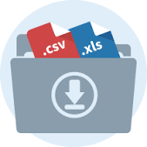

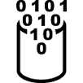



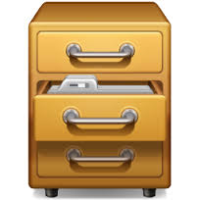

Data – where is the problem?
?
Notes:
Data intensive research is complicated, not only a research challenge but also an administrative challenge.
You start as a researcher with some data on your PC and run some analysis
Once the analysis becomes too complicated you have to move to a compute service with e.g. more memory, more cpus
So you copy your data over
Results will be transferred back. If you continue working on your data and start the computation later again you need to know whether the data on the compute server is still up to date. That is still feasible.
If computations take a very long time, the resulting data is very valuable and you want to make sure that you do not accidentally overwrite it and you would like to keep it safe for later
Actually the same is true if you receive data from a device like a genome sequencer or a telescope which you cannot reproduce (easily)
This data you also want to analyse
Some colleague likes to work and collaborate with you on your data
Share data
The colleague starts his own computations and enriches the data with other data, in any case he changes the data and wants to share the data again with you
Finally, after some time and iterations of processing of data you arrive at a publication *Yay*
Reproducible research: But which data to publish, how to link to the intermediate steps, …

Slide 5
The researchers’ needs
Store data during research
Share data during and after research
Synchronise data across different locations
Backup data
Archive data
Publish data
Link publication to processed and raw data
Find data and make data findable by others
Data transfers
Data provenance: what happened with the data
…
Notes:
We will show you some tools that can help you with these points.
Store data during research and share certain data with colleagues.
Valuable data needs to be archived.
It is nice to synchronise data between compute resources and you personal computer(s)
Once a part of your research is finished you want to publish a paper and you want or are required to link the publication to your data.
You might also want to publish data, so that you can get credit for it.
This involves describing the data appropriately so that others can find it and include it into their studies. You also need portals to conveniently search for data. These two points go hand in hand.
Throughout research on data you always need to transfer data between services and resources.
And you might want to have a tool that keeps track of what happened to the data. Unfortunately, there is no service that gathers provenance data between services …

Slide 6
Data Management
Actions that contribute to effective storage, preservation and reuse of data and documentation throughout the research lifecycle.
Data Management Plan (DMP): A document that outlines how data are to be handled both during and after a research project
research funders mandate writing a DMP
Type of data
Data & metadata standards
Data storage, sharing, & preserving
Budget & finance
Notes:
We will show you some tools that can help you with these points.
Store data during research and share certain data with colleagues.
Valuable data needs to be archived.
It is nice to synchronise data between compute resources and you personal computer(s)
Once a part of your research is finished you want to publish a paper and you want or are required to link the publication to your data.
You might also want to publish data, so that you can get credit for it.
This involves describing the data appropriately so that others can find it and include it into their studies. You also need portals to conveniently search for data. These two points go hand in hand.
Throughout research on data you always need to transfer data between services and resources.
And you might want to have a tool that keeps track of what happened to the data. Unfortunately, there is no service that gathers provenance data between services …
There is no tool that satisfies all requirements → researchers need to combine services and think about their research workflows, i.e. when to use which service.

Slide 7
The data Life cycle
CREATING DATA: designing, planning consent, collection and management, capturing and creating metadata
Creating data
Re-using data
Processing data
PROCESSING DATA: entering, transcribing, checking & validating, anonymizing and describing
RE-USING DATA: for follow-ups, new research, research reviews, scrutinising, teaching & learning
TRUST
ACCESS TO DATA: distributing, sharing, controlling access, promoting
Giving access to data
Analysing data
ANALYSING DATA: interpreting, deriving, producing outputs & publishing, preparing for sharing
Preserving data
PRESERVING DATA: migrating, backing-up, storing, creating metadata and documentation, archiving
Notes:
This is a schematic devised by the UK Data Archive to determine the different stages in which research makes use of data and needs support from infrastructures.
[shortly go through the stages]
It is pretty simplistic, but serves the purpose.
We account for that research is not a linear process and that data needs to be shared during the compute intensive steps, you can also reuse other data to enhance the analysis of your own data, you can archive raw data and so forth.

Slide 8








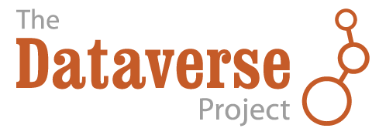



Data services in the Netherlands – there are a lot of solutions
SURF object storage
Archive
Data ingest service
Notes:
Fighting chaos with chaos.
There is no tool that satisfies all requirements → researchers need to combine services and think about their research workflows, i.e. when to use which service.

Slide 9
Data services in the Netherlands – there are a lot of solutions
SURF object storage
Archive
Data ingest service
Notes:
Fighting chaos with chaos.
There is no tool that satisfies all requirements → researchers need to combine services and think about their research workflows, i.e. when to use which service.

Slide 10
The data life cycle
Creating data
Data ingest service
Re-using data
Processing data
TRUST
Giving access to data
Analysing data
Preserving data
Notes:
Services that help to ship data after creation to right resource.

Slide 11
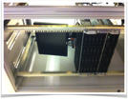
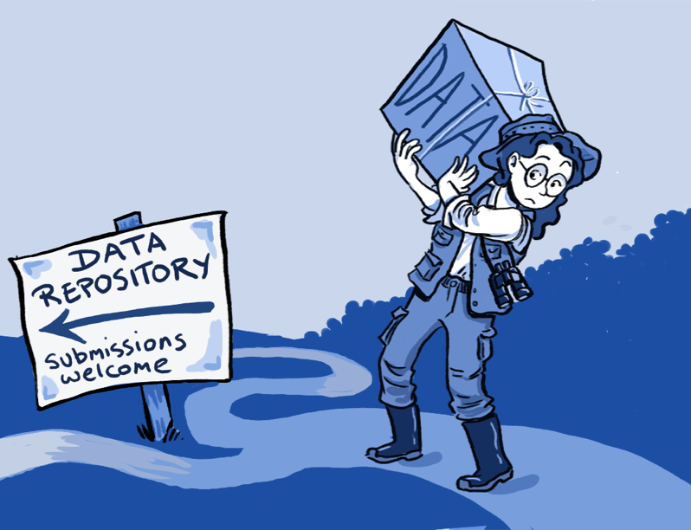

Data ingest service
Data often resides on external storage media, USB sticks, external hard drives
Slow or no internet connection
Easy way to upload large data from disk to SURFsara facilities
Upload data from 45 disks in parallel
Notes:
Still data often resides on external harddrives, which is not the best practice.
However, sometimes there is no other way, e.g. when there is no or only a slow internet connection to send data over to a storage facility.
Somehow researchers need to transport such data to a repository or other data service. SURFsara’s data ingest service offers to ingest data from disk into it’s network.

Slide 12
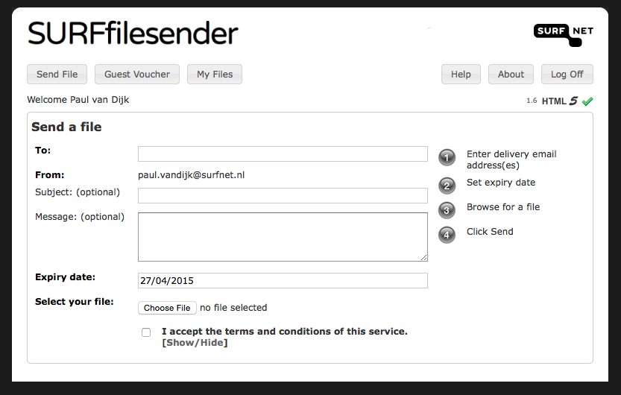
FILESENDER
Trusted community service
Transferring BIG files from person to person
File Transport service not File Storage (!)
Simple interface
Option to apply end-to-end encryption (250MB browser limit)
Vouchers for guest usage
https://filesender.surfnet.nl/

Slide 13
The data Life cycle
Creating data
Re-using data
Processing data
TRUST
Giving access to data
Analysing data
SURF object storage
SURF object storage
Preserving data
Notes:
Services that help to manage data while still working on data, services that help to work collaboratively on data.

Slide 14
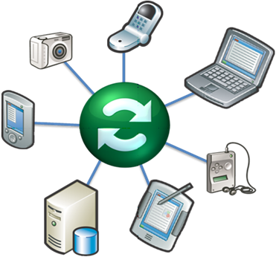

SURFdrive
Trusted community cloud for personal storage
Sharing smaller data files
Collaboration between SURFsara, SURFnet and Dutch universities
Specifications and service determined by end-users (universities)
250 GB storage capacity per user
Based on ownCloud, synchronises with local storage
Access through: surfdrive.nl

Slide 15
ResearchDrive
Share
Research
Drive
Access Methods
OwnCloud sync clients
Cyberduck
Rclone sync client
Webdav API
Trusted cloud storage for research
Similar to SURFdrive, but different focus (research)
Sharing of small to larger research data
Facilitates collaborative research
High quota’s (>250 GB) per user/group available
Sharing across similar cloud storage services
Based on ownCloud
Synchronization with local storages, Based on ownCloud
Access through: researchdrive.surfsara.nl
Access request via e-infra request
Documentation is available at: researchdrive.readthedocs.io
Notes:
Service for sharing high volume data such as image data

Slide 16
The data Life cycle
Creating data
Re-using data
Processing data
TRUST
Giving access to data
Analysing data
Preserving data
SURF object storage
Archive
Notes:
Services that help you to publish and archive your data for later re-use.

Slide 17
Cloud storage for research (Bee
SURF Object Store
Online cloud storage service
SWIFT is an object storage system
Ideal for storing various kinds of data that can grow without bound
Like amazon S3, but not the price!
Access Methods
SWIFT command line client
Next Cloud
CURL
S3 clients
Cyberduck
Python library
API
….
Current Status
Production
Documentation: https://doc.swift.surfsara.nl/en/latest/
Notes:
SWIFT is an object storage system which means that it does not have a directory-type structure like a normal file system has but it organises its data in so-called containers that contain objects. There is no tree-like structure with files and directories. There are only containers with objects in them.
More suitable for large data files, not data with metadata.
Hosting video data
MRI scans
Amazon s3

Slide 18
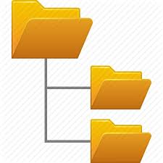

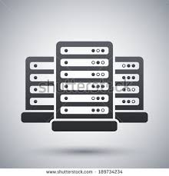
SURFsara Data Archive
Long-term storage of big data
Storage medium: Tape
→ high latency
Powerful transfer protocols:
- gridfTP
- rsync
- scp
Lisa/Cartesius
Tape
Copy data
Login
Archive
Easy access from HPC services lisa and cartesius via NFS mounts → use archive as yet another directory
Access: NWO grant, SURF e-infrastructure grant, or contract
Notes:
Workflow employing Archive from compute clusters at SURFsara:
User logs in to Lisa/Cartesius
Archive is mounted via NFS → User sees the archive as another folder
Copy data to HPC with the normal system commands
→data is still on tape, but commands on HPC have been adopted to that
Do your computations on the data
Copy data back to archive (tape)

Slide 19
The data Life cycle
Creating data
Re-using data
Processing data
TRUST
Giving access to data
Analysing data
Preserving data
Notes:
Services that help directing researchers to the correct data.

Slide 20
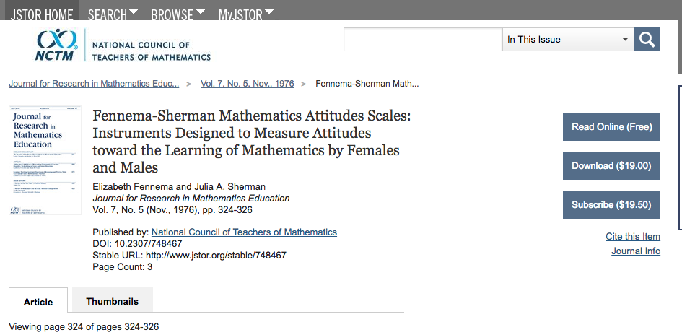
PID Service
PIDs (Persistent Identifiers) ensures the findability of your data
- Pointers to resources like files, folders, webpages, real world objects
- Globally unique
- Resolvable via http
- Comparable to ISBN numbers assigned to books
Example resolvers: https://dx.doi.org/ and http://hdl.handle.net/
A PID consists of a prefix and a postfix (11304/2e873bd8-b988-11e3-8cd7-14feb57d12b9)
10.2307/748467
Notes:
Persistent identifiers (PIDs) ensure the findability of your data, now and always. PIDs are comparable to the ISBN numbers assigned to books.
Even if the location or underlying infrastructure changes, the reference path remains intact.
A persistent identifier (PID) consists of a prefix and a postfix separated by a forward slash /. The prefix is a single number and groups one or more postfixes maintained by an institution or individual. The postfix is a unique alphanumeric string of characters. The combination of the pre- and postfix uniquely identifies a specific piece of data on a specific location by URL.
SURFsara offers a PID provisioning service in cooperation with the Persistent Identifiers for eResearch (ePIC) formerly known as European Persistent Identifier Consortium (EPIC), called the EPIC PID service.
Usually the research process starts with gathering data.
When reusing data of fellow researchers you usually get an identifier that 1) identifies the data you want use unambiguously and 2) allows you to cite and thus give credit.
Persistent identifiers help here.
After you published or finished a study you can also employ PIDs to give access and get credit for your work.

Slide 21
The data Life cycle
Creating data
Re-using data
Processing data
TRUST
Giving access to data
Analysing data
Preserving data
Notes:
Services that enable you to FIND the data you are interested. By this allowing you to effectively reuse existing data sets and create new combinations of datasets.
→ Data discovery services.

Slide 22
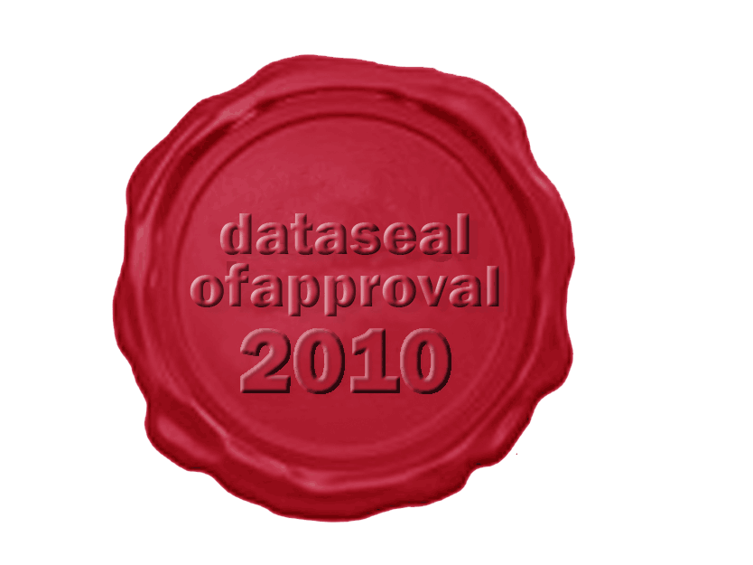
SURFsara Data Repository
Data repository service to deposit and publish data
Long-term preservation of research data
Provides quality to data sets and objects via metadata descriptions
Makes data citable and findable via Persistent Identifiers
Status: Under development
Notes:
Still data often resides on external harddrives, which is not the best practice.
However, sometimes there is no other way, e.g. when there is no or only a slow internet connection to send data over to a storage facility.
Somehow researchers need to transport such data to a repository or other data service. SURFsara’s data ingest service offers to ingest data from disk into it’s network.

Slide 23
The data Life cycle
Creating data
Data ingest service
Re-using data
Processing data
?
Swift storage service
Giving access to data
Analysing data
Preserving data
SURF object storage
Archive

Slide 24
Thank You!
Thanks to :
Christine Staiger (SURFsara)

